Slide 1

HAND GESTUER RECOGNITION
Batch Members: Supervisor:
G.SAITEJA (2010030055) Name :- Mr. Chanda Raj Kumar
G.SAMANTH (2010030272) Designation :- Assistant Professor
K.TRIBHUVAN (2010030402)
MD.ADNAN(2010030236)

Slide 2
Abstract
Hand gestures are a form of nonverbal communication that can be used in several fields such as communication between deaf-mute people, robot control, human–computer interaction (HCI), home automation and medical applications. Research papers based on hand gestures have adopted many different techniques, including those based on instrumented sensor technology and computer vision. In other words, the hand sign can be classified under many headings, such as posture and gesture, as well as dynamic and static, or a hybrid of the two. This paper focuses on a review of the literature on hand gesture techniques and introduces their merits and limitations under different circumstances. In addition, it tabulates the performance of these methods, focusing on computer vision techniques that deal with the similarity and difference points, technique of hand segmentation used, classification algorithms and drawbacks, number and types of gestures, dataset used, detection range (distance) and type of camera used. This paper is a thorough general overview of hand gesture methods with a brief discussion of some possible applications.

Slide 3
Introduction
Humans use different sensory modes like gesture, speech, facial & body expressions to interact with each other. Human Gesture Recognition is designed to cater to the needs of the fast-growing world and to minimize the hardware caring burden, It is a physical movement of hands, arms or body which conveys meaningful information regarding gestures. Hands are most important for mute and deaf people, who depend on their hands and gestures to communicate.
Hand gestures offer an inspiring field of research because they can facilitate communication and provide a natural means of interaction that can be used across a variety of applications. Previously, hand gesture recognition was achieved with wearable sensors attached directly to the hand with gloves. These sensors detected a physical response according to hand movements or finger bending. The data collected were then processed using a computer connected to the glove with wire. This system of glove-based sensor could be made portable by using a sensor attached to a microcontroller.

Slide 4
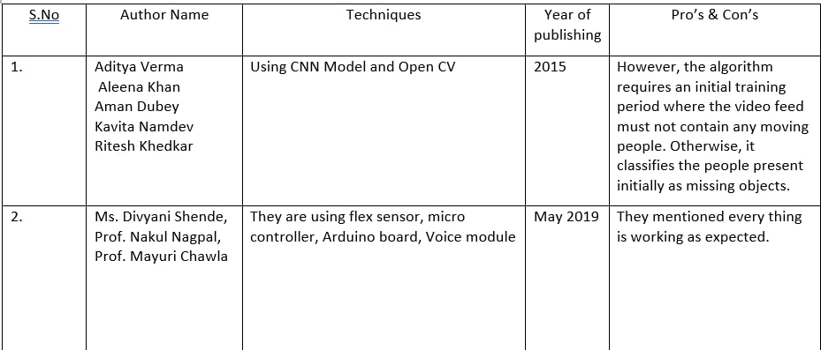
Literature Survey

Slide 5
Algorithm/Techniques/Tools Used
Template Matching
The simplest methods for recognizing hand postures is through Template matching. The template matching is a method to check whether a given data record can be classified as a member of a set of stored data records. Recognizing hand postures using template matching has two parts. The first is to create the templates by collecting data values for each posture in the posture set. The second part is to find the posture template most closely matching the current data record by comparing the current sensor readings with the given set.
Active Shapes
A technique for locating a feature within an image is called Active shape models or “smart snakes”. A contour on the image that is roughly the shape of the feature to be tracked is used. The manipulation of contour is done by moving it iteratively toward nearby edges that deform the contour to fit the feature. Active shape technique is applied to each frame and use the position of the feature in that frame as an initial approximation for the next frame.

Slide 6
Software and Hardware Requirements
Software requirements:
The major software requirements of the project are as follows:
Language : Python
Operating system : Windows 10
Tools : Jupyter Notebook, Kaggle Datasets
Hardware requirements:
The hardware requirements that map towards the software are as follows:
RAM : 4.00 GB
Processor : Intel(R) Core(TM) i5-4210U CPU @ 1.70GHz 1.70 GHz

Slide 7
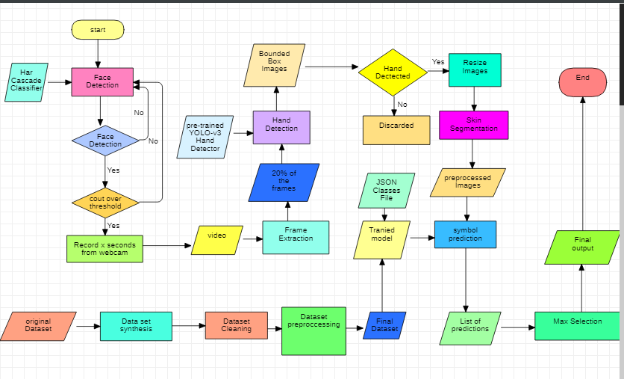
Block Diagram/Architecture

Slide 8
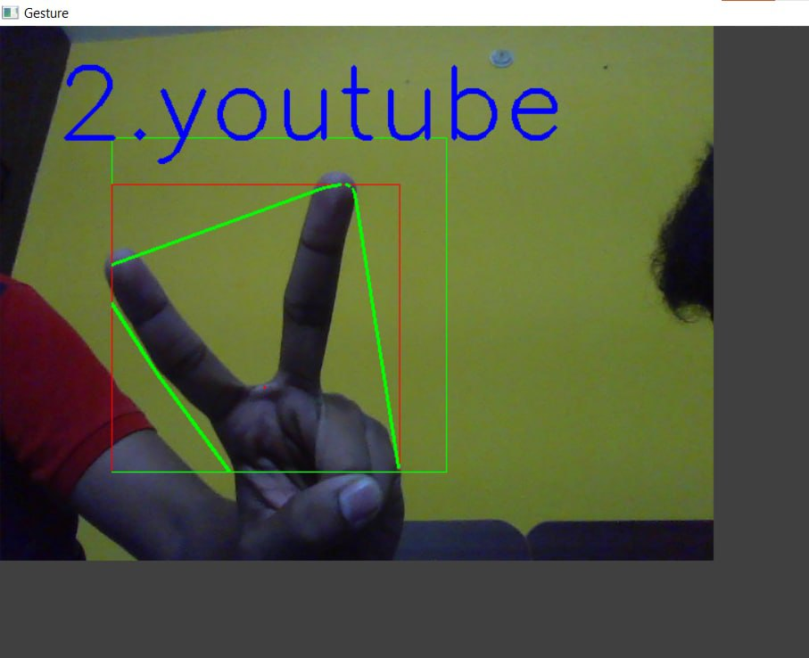
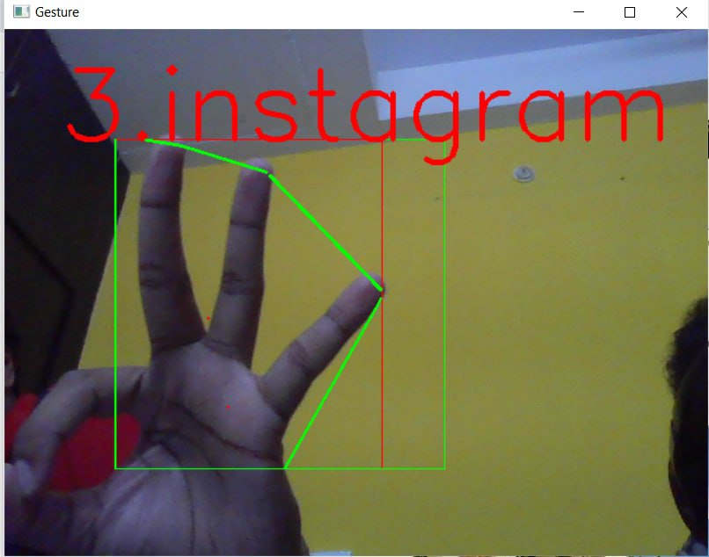
Results

Slide 9
Applications
Gesture recognition is an active research field in Human-Computer Interaction technology. It has many applications in virtual environment control and sign language translation, robot control, or music creation. In this project on Hand Gesture Recognition, we are going to make a real-time Hand Gesture Recognizer using the Tensorflow in OpenCV and Python.

Slide 10
Conclusion
In conclusion, we can confidently say that hand gestures would be a great technology to use nowadays for controlling a web browser. Users can use this technology to easily open the websites which they want in the web browser. Thus, a web browser which is controlled via hand gestures and is now implemented. This provides an expressive, natural and intuitive way of interaction through the use of hand gesture interfaces Hand gesture recognition addresses a fault in interaction systems.

Slide 11
Future Scope
Controlling things by hand is more natural, easier, more flexible and cheaper, and there is no need to fix problems caused by hardware devices, since none is required. From previous sections, it was clear to need to put much effort into developing reliable and robust algorithms with the help of using a camera sensor has a certain characteristic to encounter common issues and achieve a reliable result. Each technique mentioned above, however, has its advantages and disadvantages and may perform well in some challenges while being inferior in others.

Slide 12
References
• Gupta H.P., Chudgar H.S., Mukherjee S., Dutta T., Sharma K. A continuous hand gestures recognition technique for human-machine interaction using accelerometer and gyroscope sensors. IEEE Sens. [Google Scholar]
•Ahuja M.K., Singh A. Static vision based Hand Gesture recognition using principal component analysis; Proceedings of the 2015 IEEE 3rd International Conference on MOOCs, Innovation and Technology in Education (MITE); Amritsar, India. 1–2 October 2015; pp. 402–406. [Google Scholar]
•Kramer R.K., Majidi C., Sahai R., Wood R.J. Soft curvature sensors for joint angle proprioception; Proceedings of the 2011 IEEE/RSJ International Conference on Intelligent Robots and Systems; San Francisco, CA, USA. 25–30 September 2011; pp. 1919–1926. [Google Scholar]

Slide 13
Thank You

